Slide 1
The Linux Command Line Chapter 4
Manipulating Files And Directories
Prepared by Dr. Reyes, New York City College of Technology

Slide 2
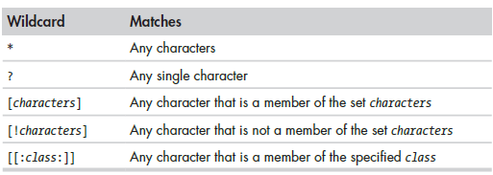
Wildcards
Wildcards - allows you to select filenames based on patterns of characters.

Slide 3
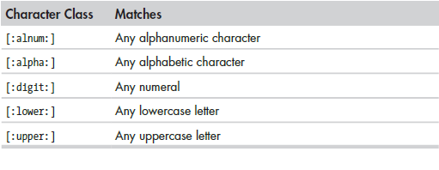
Character Classes

Slide 4
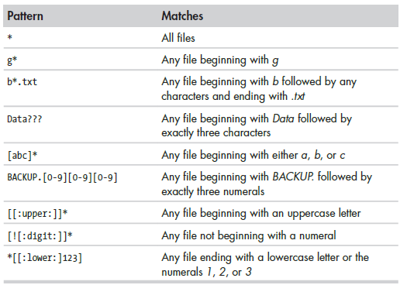
Wildcards examples

Slide 5


mkdir Command
mkdir – creates a directory or multiple directories

Slide 6
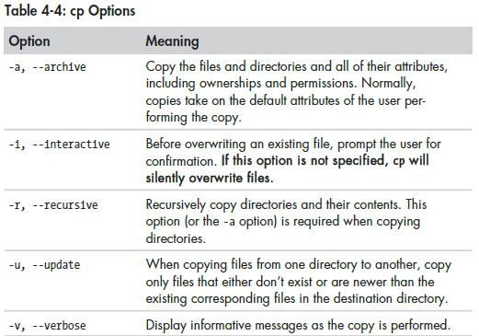
cp Command
cp – copies a file(s) or directory

Slide 7
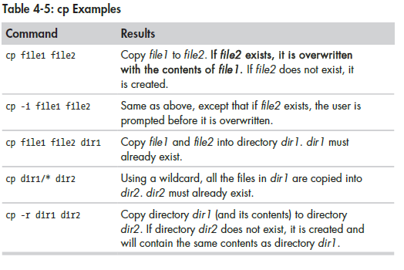
cp examples

Slide 8
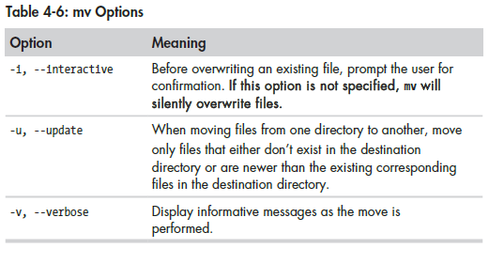
mv Command
mv - performs file moving or file renaming

Slide 9
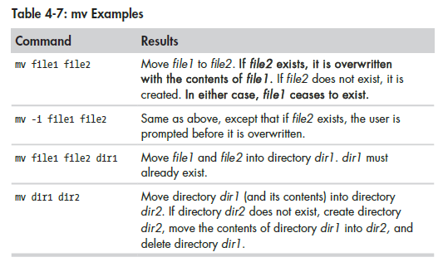
mv Examples

Slide 10
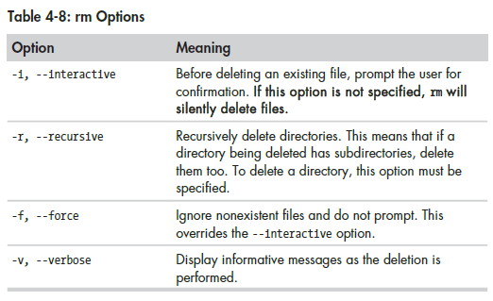
rm Command
rm - used to remove files and directories

Slide 11
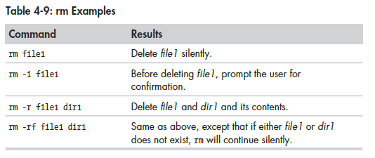
rm Examples

Slide 12
ln Command
ln - used to create either hard or symbolic links
Hard Links - ln file link
Symbolic Link - ln -s item link
Hard Links - The original Unix way of creating links. It cannot reference a file outside its own filesystem and cannot reference a directory.
Symbolic Links - creates a special file with a pointer to the referenced file or directory, similar to a shortcut in Windows.

